Slide 1
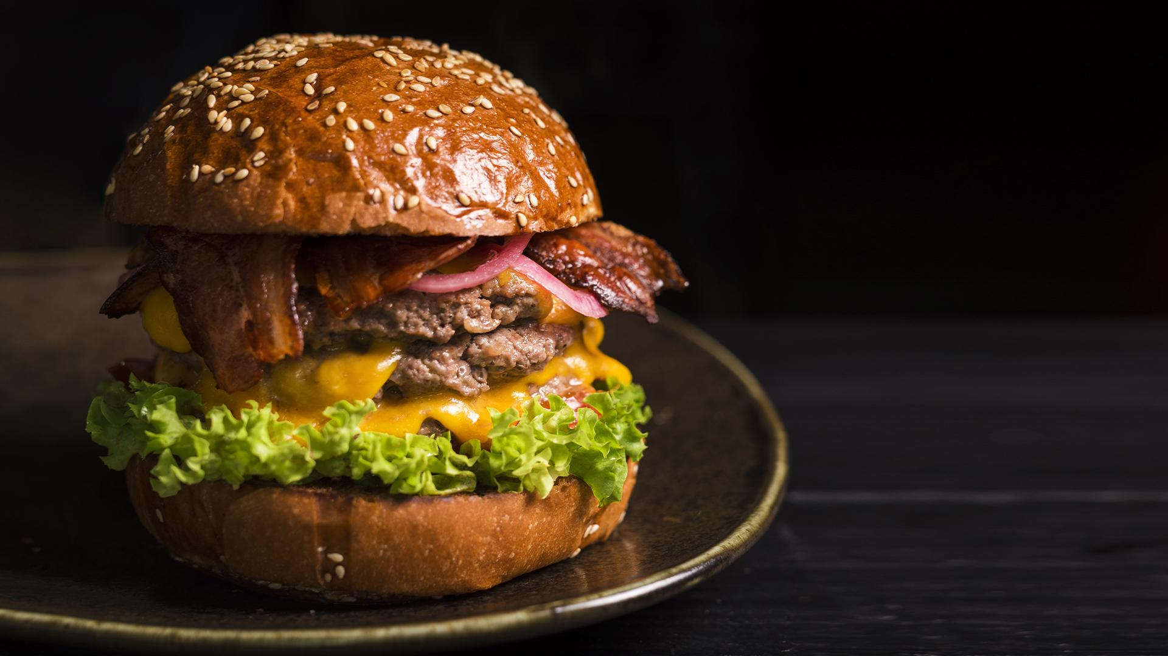

Nutrition Facts for McDonald's Menu
STA 9750 Final Project
Presented by :Xiaojin Li

Slide 2

Dataset introduction
Categorical | Quantitative | Quantitative(% Daily Value)
Category | Calories(My y) | Total Fat (% Daily Value)
Item | Calories from Fat | Saturated Fat (% Daily Value)
Serving Size | Total Fat | Cholesterol (% Daily Value)
 | Trans Fat | Sodium (% Daily Value)
 | Saturated Fat | Carbohydrates (% Daily Value)
 | Cholesterol | Dietary Fiber (% Daily Value)
 | DietaryFiber | Vitamin A (% Daily Value)
 | Protein | Vitamin C (% Daily Value)
 | Sugars | Calcium (% Daily Value)
 | Sodium | Iron (% Daily Value)
 | Carbohydrates
In total 24 variables,
3 categorical variables,
21 quantitative variables
Source: https://www.kaggle.com/datasets/mcdonalds/nutrition-facts?datasetId=910&sortBy=voteCount

Slide 3
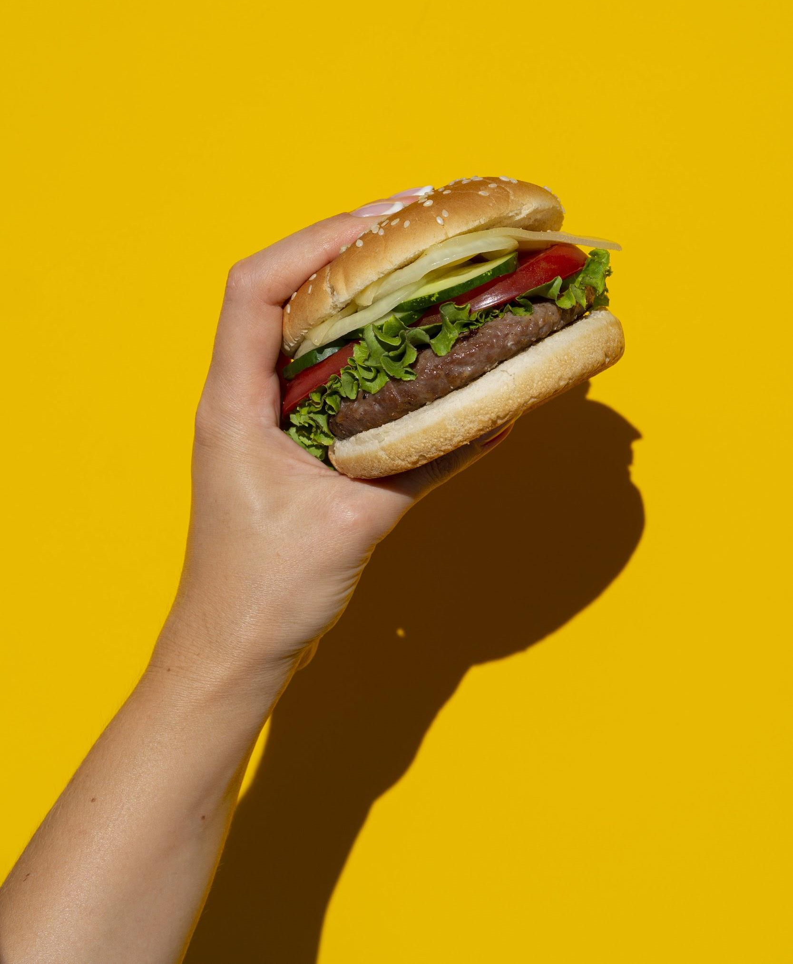
Data cleaning
Categorical | Quantitative | Quantitative (User added)
Category | Calories(My y) | Serving Size in oz 4.8
Item | Total Fat
Serving Size 4.8 oz (136 g) | Calories from Fat
4.8 oz (136 g) | Trans Fat
 | Saturated Fat
 | Cholesterol
 | DietaryFiber
 | Protein
 | Sugars
 | Sodium
 | Carbohydrates

Slide 4

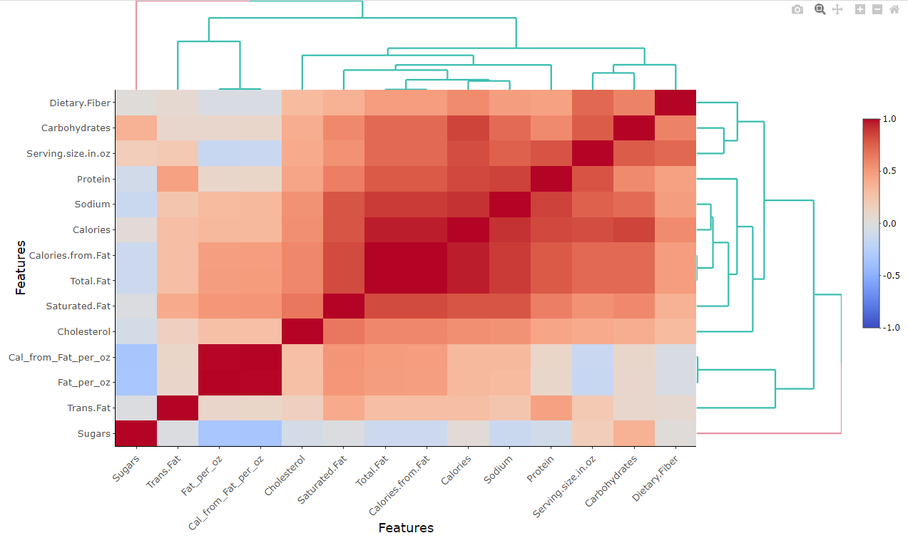
Data cleaning
Correlation heatmap:representing the correlation between different variables

Slide 5

My dataset
Categorical
Quantitative
Check missing value
Understand my data
sum(is.na(data))
summary(data)
Category
Item
Calories(My y)
Total Fat
Sodium
Carbohydrates
Protein

Slide 6
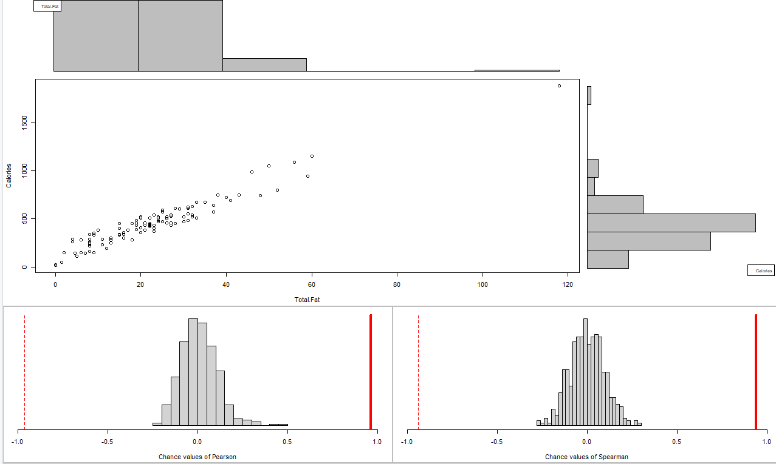
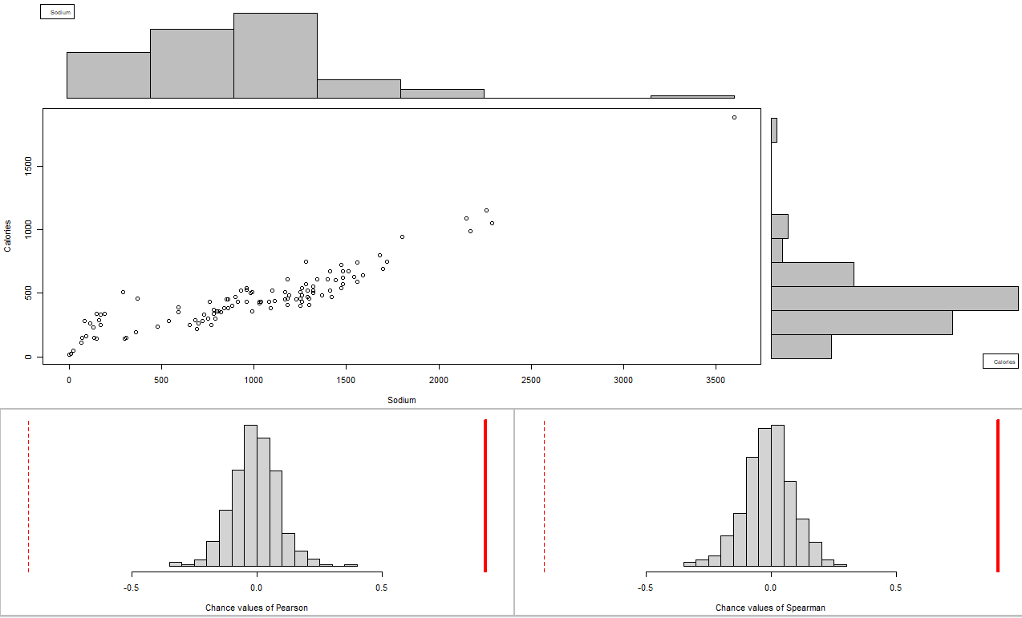
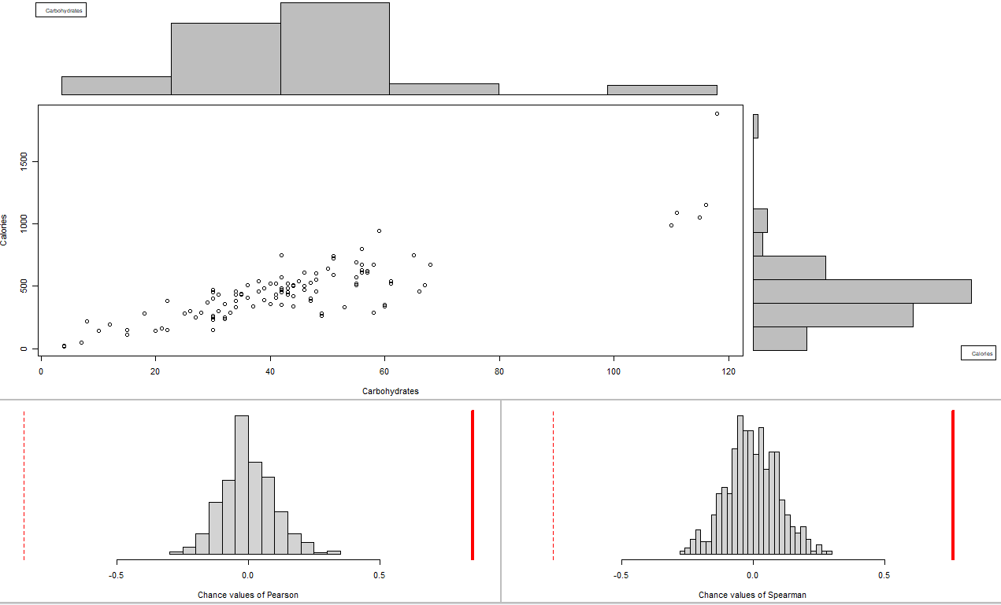
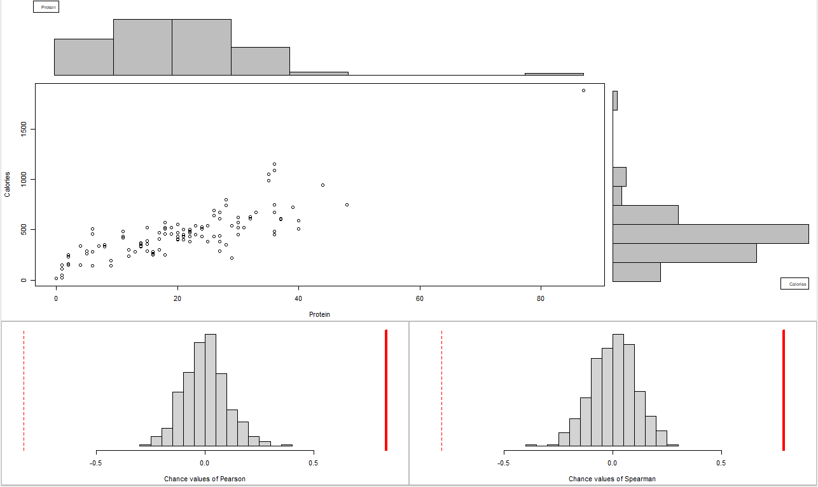
Association analysis
Between Two Quantitative Variables
X Variables | Correlation coefficient | P value | Conclusion
Total Fat | 0.9397042 | 0 | Significant Strong Association
Sodium | 0.9041105 | 0 | Significant Strong Association
Carbohydrates | 0.7635398 | 0 | Significant Strong Association
Protein | 0.7877784 | 0 | Significant Strong Association
Y=Calories
X=Total fat
Y=Calories
X=Sodium
Y=Calories
X=Carbohydrates
Y=Calories
X=Protein
Y=Sodium
X=Total fat

Slide 7
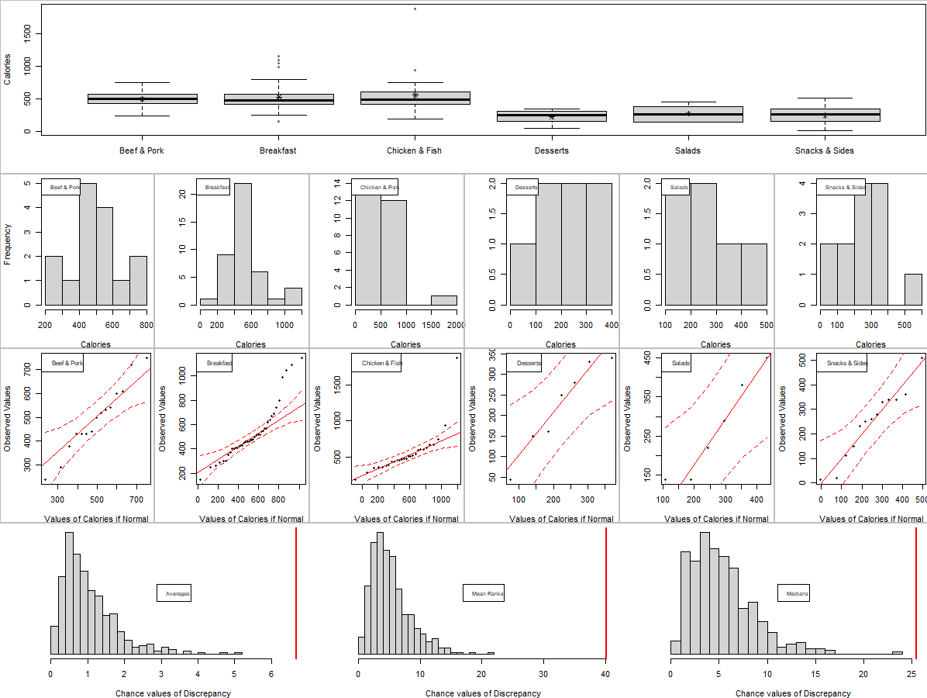
Association analysis
Between a Categorical and Quantitative Variable
X Variables | P value | Conclusion
Category | 0 | Significant Association
Y=Calories
X=Carbohydrates
Y=Calories
X=Protein
Y=Sodium
X=Total fat

Slide 8
Regression Analysis
Model | Slope | Slope’s P value (<0.05) | 95% confidence interval (Included 0 or not) | R squared | Residual standard error
Calories~Total Fat | 15.32 | Yes | No | 0.93 | 68.05
Calories~Sodium | 0.39 | Yes | No | 0.83 | 103
Calories~Carbohydrates | 10.23 | Yes | No | 0.73 | 129.7
Calories~Protein | 16.31 | Yes | No | 0.70 | 138.2
All numbers above are all rounded two digits

Slide 9

Summary
The association shows that the correlation between calories and all other x variables is strong
Compared with other models, the simple linear regression model using total fat as a predictor seems the best model. Because this model has the lowest RMSE and the highest R squared

Slide 10
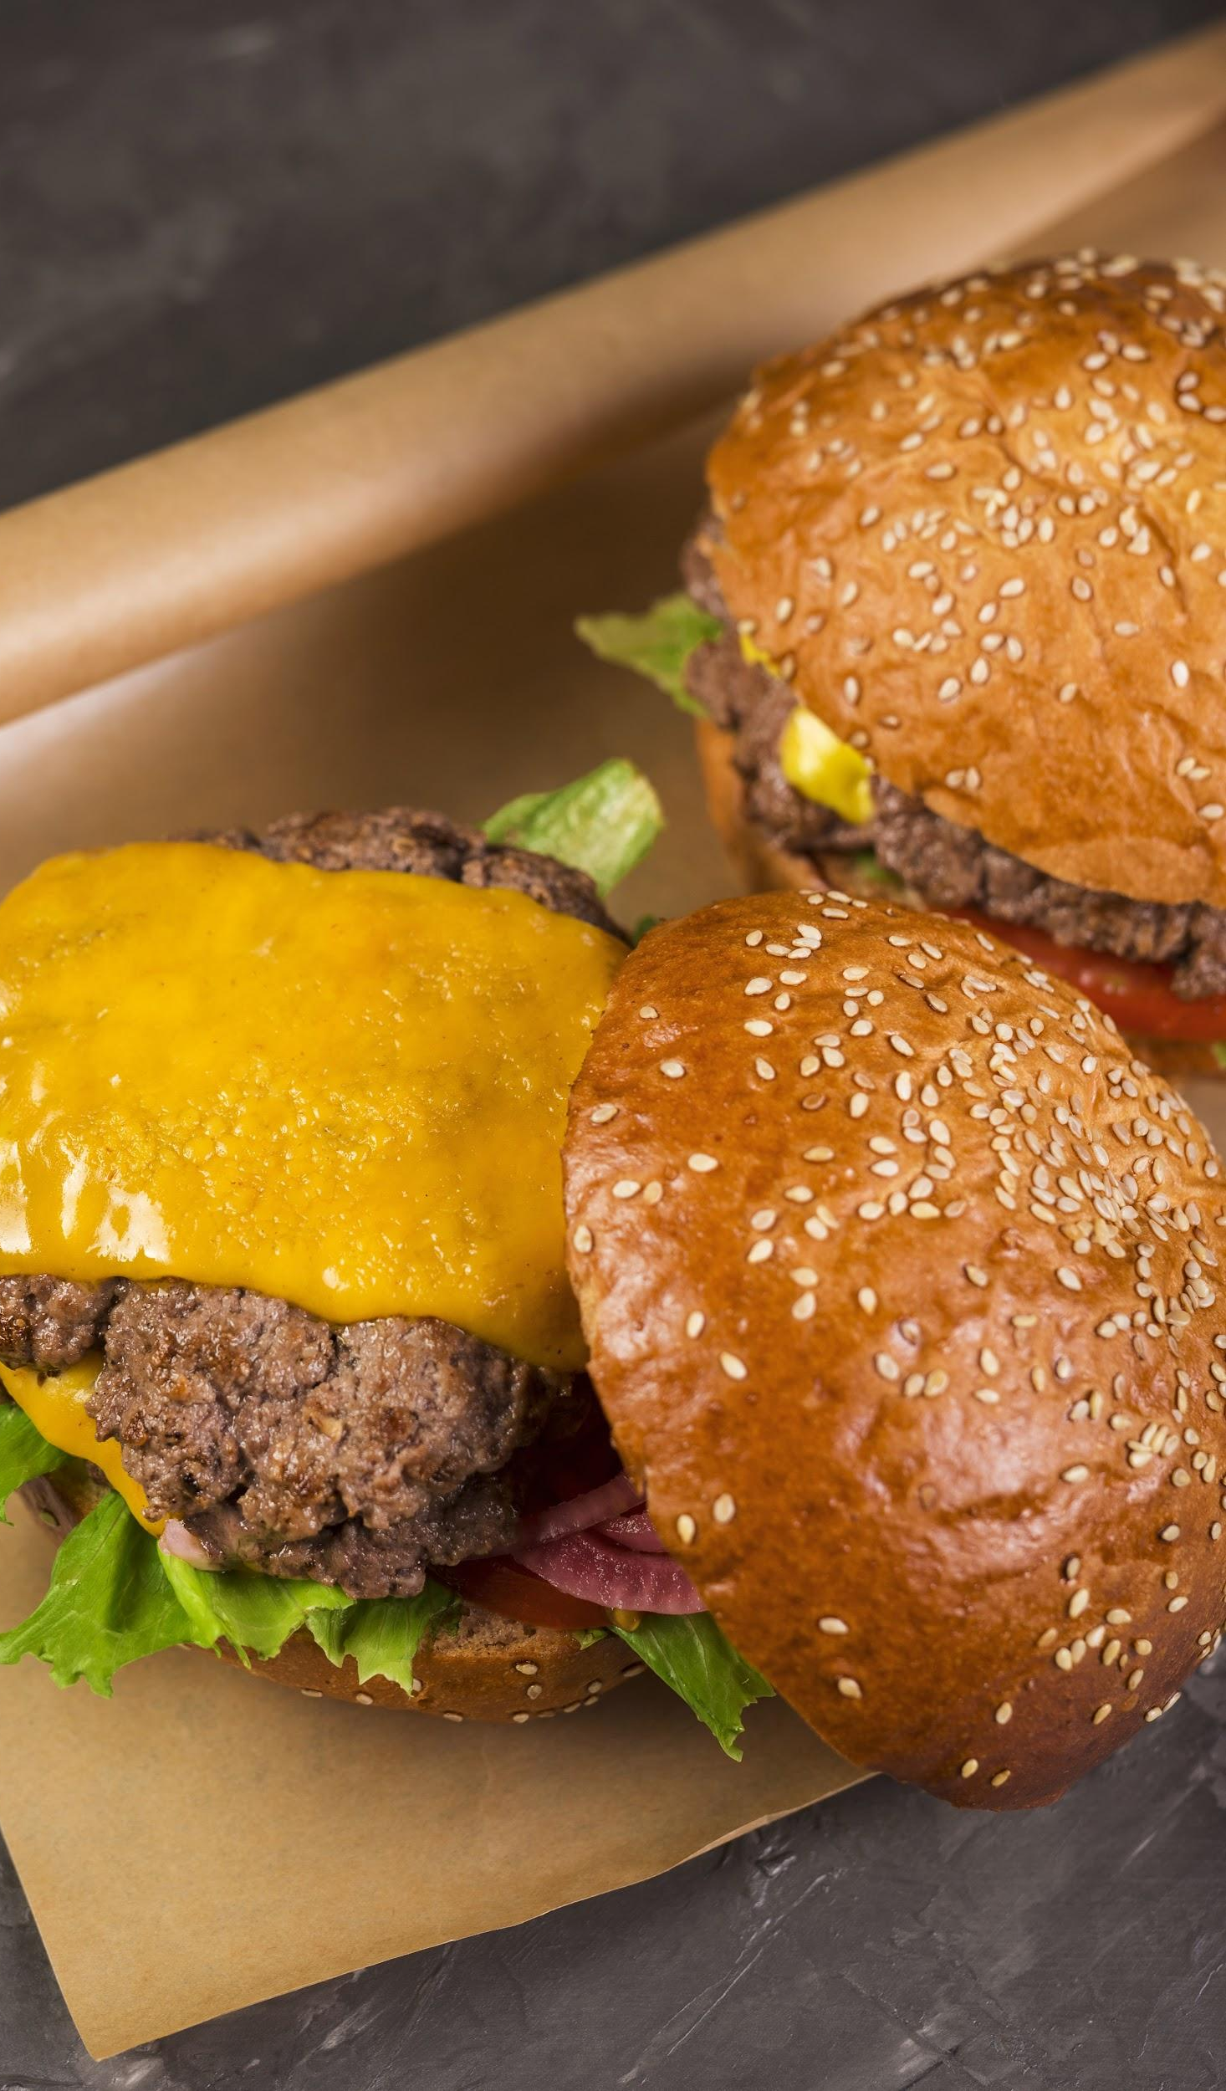


Thank You

